Slide 1
Front-End Web Development
Introduction to www

Slide 2

Presentation Contents
What is HTML?
What is CSS?
What is JavaScript?

Slide 3
Course objectives
Describe how the HTML, CSS and JavaScript components can create a website

Slide 4
What is HTML?
HTML stands for Hyper Text Markup Language
HTML is used to define the structure of a web page
A simple HTML structure is shown in the example to the right
As we can see, opening and closing tags are used in a HTML document
Tags are know as HTML elements. A browser will use the tags to render the specified content on the web page
<!DOCTYPE html>
<html>
<head>
<title>Tab Bar Title</title>
</head>
<body>
<h1>This is a Heading</h1>
<p>This is a paragraph.</p>
</body>
</html>

Slide 5
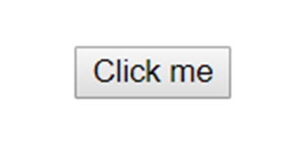
What is HTML?
HTML tags make up everything displayed on a web page.
For every element you see or interact with on a web page i.e. headings, paragraphs, tables, form fields, buttons etc. there is a tag to represent it
In the example, we can see how a button HTML element tag would be displayed in a browser
<button>Click me</button>

Slide 6
HTML5
HTML5 is a collection of technologies.
Browser support can be inconsistent, especially on slightly older browsers

Slide 7
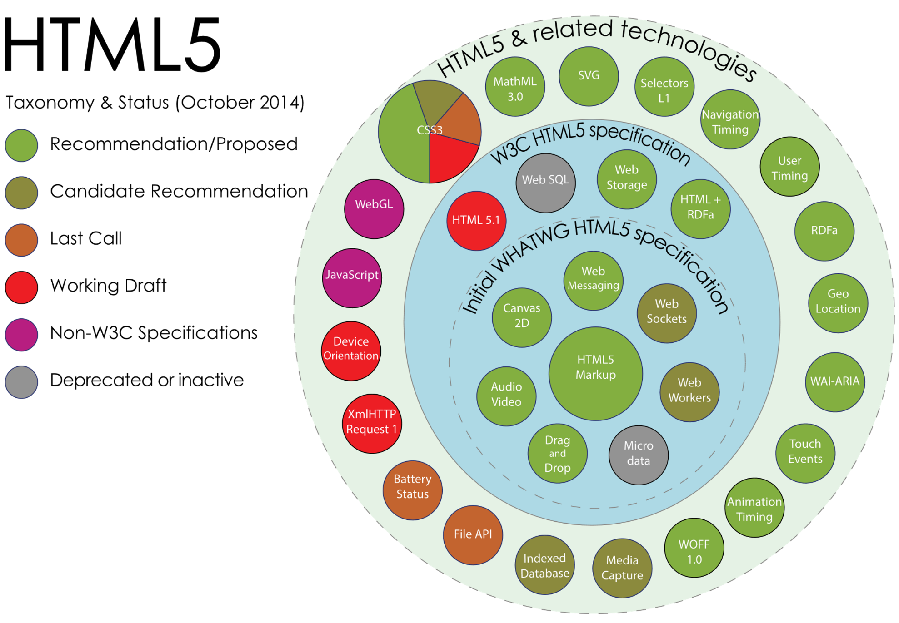
HTML5 TAXONOMY & STATUS
We don’t need to know all of these to get started with HTML5 however it is useful to understand how HTML5 is structured.
By Mercury999 - Own work, CC BY-SA 4.0, https://commons.wikimedia.org/w/index.php?curid=36352535

Slide 8
Document Object Model
The DOM (Document Object Model) is a convention for representing and interacting with objects in a mark-up language.
This convention is cross-platform and language-independent.
The DOM utilises a tree structure to provide a logical and easily representable layout.
We can traverse this structure within code, travelling to nodes (objects) through the hierarchical layout.
The DOM in HTML is defined by the order of tags within the document.

Slide 9
Document Object Model
<!DOCTYPE html>
<html>
<head></head>
<body>
<div id="header">
<h1>Welcome to WebExample.com!</h1>
</div>
<div id="content">
<h2>Homepage</h2>
<p>There is nothing on this website.</p>
</div>
<div id="footer">
<p>Contact admin@webexample.com.</p>
</div>
</body>
</html>
Document
<html>
<head>
<body>
<div id=“header>
<div id=“content”>
<h1>
<p>
<h2>
<p>
Notes:
https://www.w3schools.com/html/tryit.asp?filename=tryhtml_basic

Slide 10
Practice activities
Directions
5 minutes
Find out the correct HTML element tag that would create a text field for a user to type information and the HTML element tag that would create a checkbox to allow a the user to select and deselect
Debrief
Discover syntax for some HTML elements

Slide 11
Solution
Text field
<input type=“text” >
Checkbox
<input type=“checkbox” >

Slide 12
What is CSS?
CSS stands for Cascading Style Sheets
CSS is used to change the look and feel of our HTML content
Think of HTML as a chair and CSS as the fabric you use to cover the chair
Bootstrap is a very popular and widely used framework of CSS that we can link to HTML files
There are actual guidelines for CSS relating to things such as the styling and sizes of text to ensure it is actually readable for usability requirements and to adhere legal requirements of accessibility

Slide 13
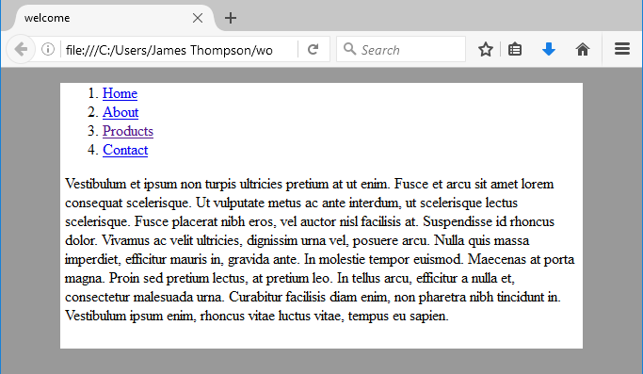
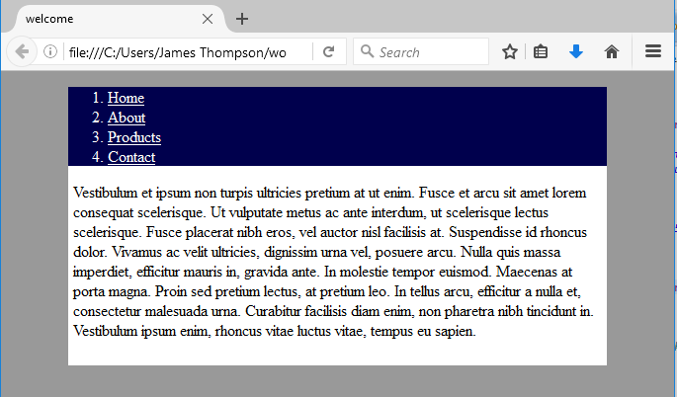
CSS Example
Applying the CSS rule below to the appropriate HTML element would cause a change in the navigation bar as shown the on the right. The bottom right picture being the navigation bar after the CSS rule was applied.
background-color: darkblue;

Slide 14
What is JavaScript?
JavaScript is the Programming Language for the Web
JavaScript can update and change both HTML and CSS
JavaScript can calculate, manipulate and validate data
JavaScript is considered one of the most popular programming languages
Numerous frameworks are built on JS, can you name any?
Notes:
https://www.w3schools.com/whatis/whatis_js.asp

Slide 15
Characteristics of JavaScript
JavaScript is a functional language.
Revolves around the creation and implementation of functions throughout the code
Even though ‘Java’ is part of the name, it’s not the same!
The term ‘script’ implies its not a real programming language, but this is also not the case
JavaScript was designed to be ran in the browser
The browser is a hostile programming environment – different browsers will interpret JS in different ways.

Slide 16
The Vastness of JavaScript
Libraries
A library is reusable code that provides certain functionalities
You import a library to use its collection of functions, objects, and classes that you can use in your application
Frameworks
A framework provides a skeleton for how everything should be organised in your application. You are provided the functionality needed to get the application up and running.
Using a framework will ensure you stick to the frameworks design principles and patterns.
Notes:
https://en.wikipedia.org/wiki/Comparison_of_JavaScript_frameworks
https://en.wikipedia.org/wiki/List_of_JavaScript_libraries
https://www.npmjs.com
Examples of libraries: Network protocols, compression, image manipulation, string utilities, regular expression evaluation, math. Operations are self-contained.
Examples of frameworks: Web application system, Plug-in manager, GUI system. The framework defines the concept but the application defines the fundamental functionality that end-users care about.

Slide 17
Course Objectives – Summary
Describe how the HTML, CSS and JavaScript components can create a website
HTML is used to define the structure of a web page
CSS is used to change the look and feel of our HTML content
JavaScript is the Programming Language for the Web, it has the ability to calculate, manipulate and validate data can is used to update and change both HTML and CSS.

Slide 18
Thank you for listening.
Any Questions?

